Slide 1
GIS Analytics
Lecture 8: Exploratory Spatial Data Analysis (ESDA)
CLUSTERING

Slide 2
Introduction to Spatial Cluster Analysis
What is Spatial Cluster Analysis?
Definition: Detects patterns in geographic data where similar values are spatially clustered.
Examples: Crime hotspots, disease outbreaks, traffic incidents.
Why it’s important: Helps identify regions with statistically significant concentrations of events or values.

Slide 3
Types of Spatial Clustering
Point-based clustering: Focuses on clustering of individual events (e.g., DBSCAN).
Global clustering: Assesses overall spatial clustering across the dataset (e.g., Moran's I).
Local clustering: Identifies localized clusters of high or low values (e.g., LISA, Getis-Ord Gi*).

Slide 4
Key Concepts in Spatial Clustering
Spatial autocorrelation: The idea that nearby locations are more likely to have similar values.
Cluster: Group of spatial data points that are close to each other based on a distance measure.
Outliers: Points that don't fit into any cluster or are isolated from clusters.

Slide 5
Steps in Conducting Spatial Cluster Analysis (Practical)
1. Data: Ensure proper geocoding, projection (CRS), and data cleaning.
2. Define spatial relationships: Choose an appropriate spatial weights matrix.
3. Choose a clustering method: Global (e.g., Moran’s I) vs. local (e.g., Getis-Ord).
4. Interpretation: Assess results for statistically significant clusters.

Slide 6
Spatial Scale
Ignoring spatial scale: Different patterns emerge at different scales.
Choosing wrong spatial weights: Results depend heavily on how you define spatial relationships.
Not accounting for data quality: Missing or misaligned data can skew results.
Overinterpreting randomness: Understand the limits of statistical significance

Slide 7
Types of Distribution
Three general patterns:
Random any point is equally likely to occur at any location and the position of any point is not affected by the position of any other point. There is no apparent ordering of the distribution
Uniform every point is as far from all of its neighbors as possible
Clustered many points are concentrated close together, and large areas that contain very few, if any, points

Slide 8
K-means Clustering
Fixed number of clusters.
How it works: Minimizes variance within clusters and maximizes variance between clusters.
Limitations: Requires pre-specifying the number of clusters, not spatially aware.

Slide 9
DBSCAN (Density-Based Clustering)
Identifies clusters based on density of points.
Outliers: Naturally identifies noise and outliers.
Advantages: Doesn’t require specifying the number of clusters, handles irregular shapes.

Slide 10
HDBSCAN (Hierarchical Density-Based Spatial Clustering
HDBSCAN groups together points that are close to each other, based on how "dense" their neighborhood is.
If there are areas with many points packed closely together, HDBSCAN identifies them as a cluster.
Unlike DBSCAN, which struggles when clusters have different densities, HDBSCAN works well even when some clusters are denser than others.
It adjusts itself to detect clusters of varying shapes and densities.

Slide 11
Hierarchical
HDBSCAN builds a hierarchy of clusters from dense core areas to sparser, more diffuse areas.
You can think of it as creating layers of clusters—denser core clusters can have subclusters or merge into larger, less dense clusters.

Slide 12
Spatial Weights in Cluster Analysis
The Role of Spatial Weights
Spatial weight matrix: A mathematical construct that defines the spatial relationships between locations.
Types of weights:
Contiguity-based: Defines neighbors based on shared boundaries.
Distance-based: Defines neighbors based on proximity (Euclidean distance).
Importance: Influences how clusters are identified in spatial data.

Slide 13

Nearest neighbor analysis (NNA)
A spatial statistical method used to assess the distribution and clustering of points in a given space.
It helps determine whether the observed pattern of points is random, clustered, or uniformly distributed.
NNI is calculated as:

Slide 14
HeatMAPS & Getis-Ord Gi Statistic: Hotspot Analysis
Purpose: Identifies statistically significant hotspots or cold spots based on spatial aggregation of high/low values.
How it works: Measures the intensity of clustering around each point relative to neighbors.
Application: Crime mapping, disease outbreaks, socioeconomic studies.

Slide 15
Key Functions of Nearest Neighbor Analysis
Measure Spatial Arrangement:
NNA evaluates the distance between a point and its nearest neighbor.
By analyzing these distances across a dataset, it provides insight into the overall spatial arrangement of points.
Compare Observed vs. Expected Patterns:
It compares the observed average nearest neighbor distance to an expected average distance under the assumption of complete spatial randomness.
This helps determine if the points are clustered, dispersed, or randomly distributed.

Slide 16
Quantify Clustering:
By calculating the nearest neighbor index (NNI), it quantifies the degree of clustering:
NNI < 1: Indicates clustering (points are closer together than expected).
NNI = 1: Suggests a random distribution (points are spaced as expected).
NNI > 1: Indicates dispersion (points are farther apart than expected).

Slide 17
Applications of Nearest Neighbor Analysis
Urban Planning:
Helps analyze the distribution of facilities, such as schools, parks, or hospitals, to ensure equitable access and optimal placement.
Crime Analysis:
Assists in understanding the spatial patterns of criminal incidents, which can help law enforcement agencies target resources effectively.
Epidemiology:
Useful for studying the spread of diseases by analyzing the spatial distribution of disease cases to identify clusters.
Real Estate and Market Analysis:
Used to assess the spatial distribution of properties, businesses, or other entities, informing investment decisions and marketing strategies.

Slide 18
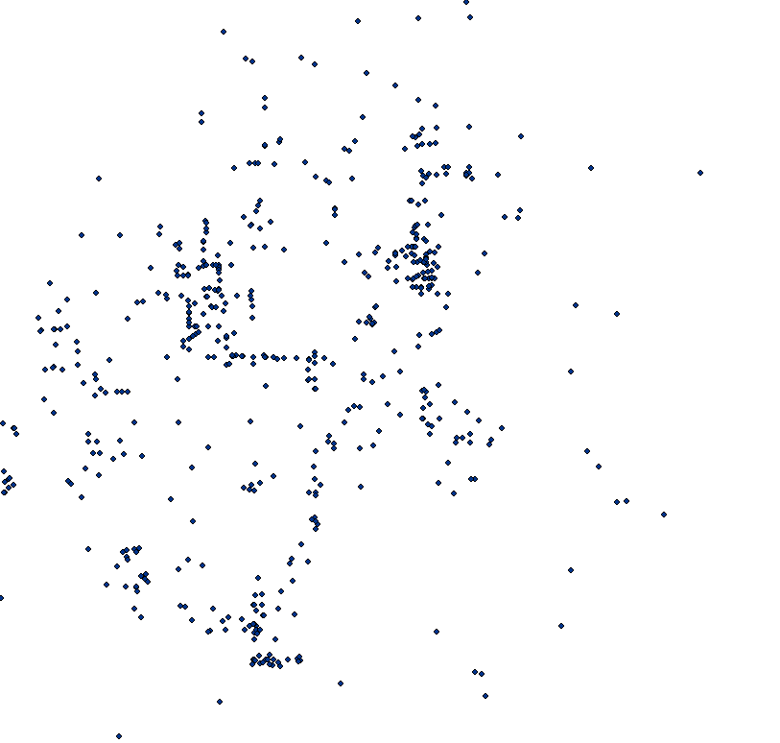
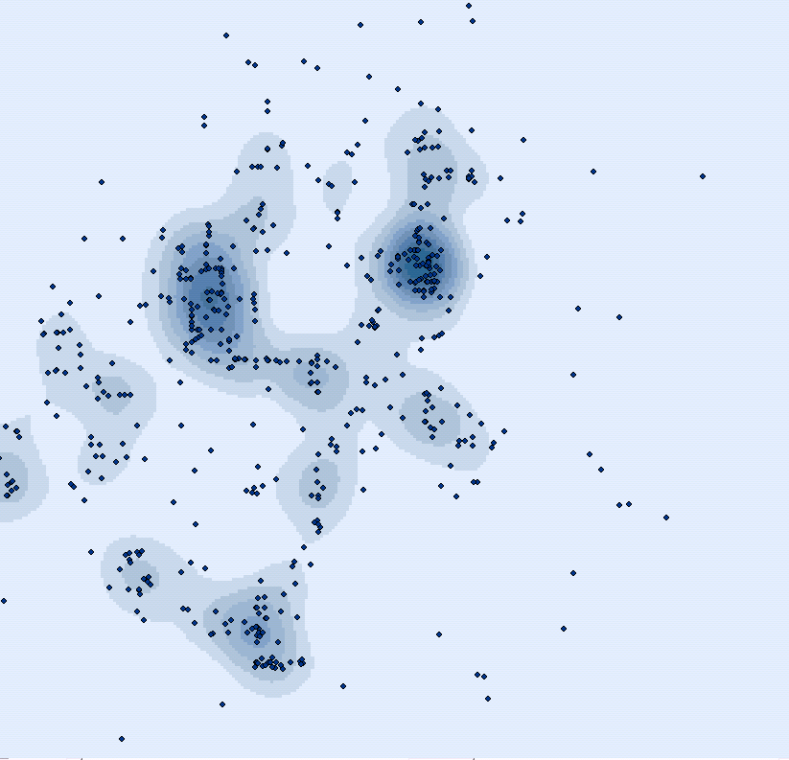
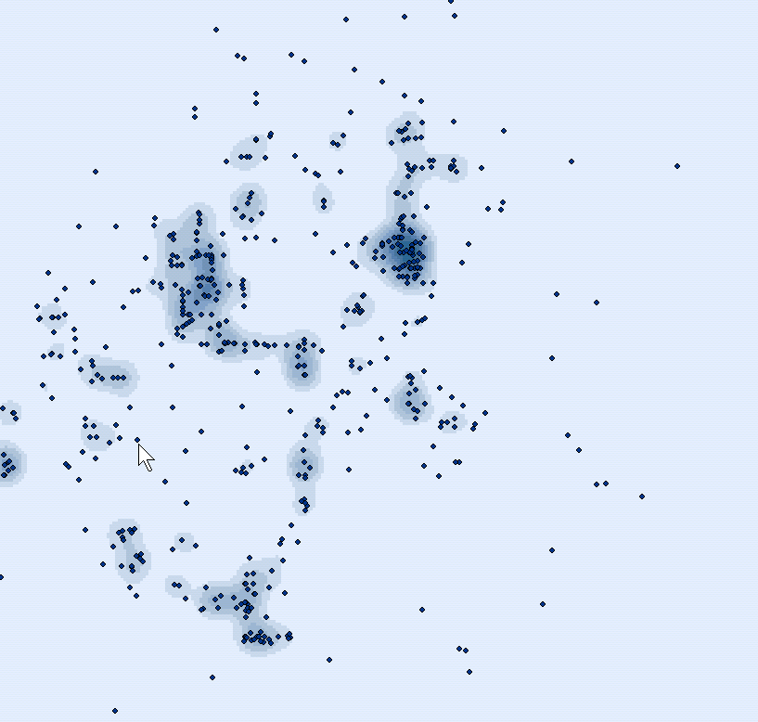
Density Kernel Estimation
commonly used to “visually enhance” a point pattern
Is an example of “exploratory spatial data analysis” (ESDA)
Kernel=10,000
Kernel=5,000

Slide 19
Density Kernel Estimation
Radii surrounding each point are based on a quadratic formula with the highest value of observations assumed to be at the center (the point location), then tapering to zero at the radius distance.
Kernel density calculates a "magnitude per search radius" from a point using a kernel function to fit a smoothly tapered surface to each point.
Note that while density maps can show where clusters exist in your data, they do not indicate whether there are statistically significant differences between clusters.

Slide 20
Heatmaps (Kernel Density Estimation)
Visualize the concentration of points by calculating the density of points in a given area.
This is a non-clustering method but helps visualize where clusters of points are located.
Use Case: This is used to find areas of high concentration of arrests, even if they are not formal clusters.

Slide 21
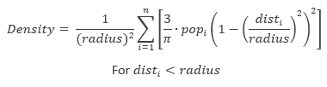
Density Kernel Estimation
Pop is equal to one unless we want to weight results to a column value
We choose the radius
Dist is the distance from a point in a grid cell and any points within the radius…
Formula:

Slide 22
Quadrat Analysis
Based on a measure derived from data obtained after a uniform grid network is drawn over a map of the distribution of interest
The frequency count, the number of points occurring within each quadrat is recorded first
These data are then used to compute a measure called the variance
The variance compares the number of points in each grid cell with the average number of points over all of the cells
The variance of the distribution is compared to the characteristics of a random distribution

Slide 23
Quadrats
RANDOM
UNIFORM
CLUSTERED

Slide 24
Quadrat Calculation
Mean = # of points / # of quadrats
Notes:
The variance to mean ratio indicates the type of point pattern: if it’s close to one it is random. If it’s close to zero, it’s uniform. And if it is above one then it is more clustered.

Slide 25
Quadrat Calculation Results
A random distribution would indicate that that the variance and mean are the same. Therefore, we would expect a variance-mean ratio around 1
Values other than 1 would indicate a non-random distribution.

Slide 26
Weakness of Quadrat Analysis
Quadrat size and orientation
If the quadrats are too small, they may contain only a couple of points. If they are too large, they may contain too many points – a scale issue.
Test different sizes to determine the effects of each test on the results

Slide 27
Nearest-Neighbor Analysis
Unlike quadrat analysis, uses distances between points as its basis.
The mean of the distance observed between each point and its nearest neighbor is compared with the expected mean distance that would occur if the distribution were random

Slide 28
Nearest-Neighbor Analysis
RANDOM
UNIFORM
CLUSTERED

Slide 29
Nearest-Neighbor Calculation
Clustered
Patterns are
Closer to 0 on R
Notes:
The Average Nearest Neighbor tool measures the distance between each feature centroid and its nearest neighbor's centroid location. It then averages all these nearest neighbor distances.
If the average distance is less than the average for a hypothetical random distribution, the distribution of the features being analyzed is considered clustered. If the average distance is greater than a hypothetical random distribution, the features are considered dispersed.
The average nearest neighbor ratio is calculated as the observed average distance divided by the expected average distance (with expected average distance being based on a hypothetical random distribution with the same number of features covering the same total area).
Random patterns are closer to 1 on R
Clustered Patterns are Closer to 0 on R
Dispersed patterns are above 1 on R

Slide 30
Advantages of Nearest Neighbor over Quadrat Analysis
No quadrat size problem to be concerned with
Takes distance into account
Problems:
Related to the entire boundary size
Must consider how to measure the boundary
Arbitrary or some natural boundary (need theory)
May not consider a possible adjacent boundary

Slide 31
Is it clustered?

Slide 32
Choosing the Right Method:
DBSCAN or HDBSCAN: For data with uneven density and outliers.
K-means: If you want a fixed number of clusters.
*Getis-Ord Gi (Hotspot)**: To identify statistically significant hotspots.
Heatmap: To visualize concentration without actual cluster boundaries.
Moran’s I and LISA: To analyze spatial autocorrelation and localized clusters.
Quadrat Analysis: For uniform area analysis and grid-based clustering.

Slide 33
1. Spatial Autocorrelation
Definition: Spatial autocorrelation refers to the degree to which a set of spatial data points resemble or differ from each other based on their location.
Types of Spatial Autocorrelation:
- Positive: Similar values cluster together.
- Negative: Dissimilar values are near each other.
- No Autocorrelation: Random distribution.
Importance: Helps identify patterns and understand spatial processes.

Slide 34
2. Moran's I
Definition: Moran's I quantifies spatial autocorrelation, indicating whether values are randomly distributed or show clustering.
Formula:
I = (n/W) * (ΣΣw_ij(x_i - x̄)(x_j - x̄)) / Σ(x_i - x̄)^2
Interpretation:
- I = +1: Perfect positive autocorrelation.
- I = 0: No autocorrelation.
- I = -1: Perfect negative autocorrelation.

Slide 35
3. Example of Moran's I
Scenario: Analyze crime rates across neighborhoods in a city.
Using Moran’s I, determine whether neighborhoods with high crime rates are clustered (positive) or randomly distributed (no autocorrelation).

Slide 36
4. Steps to Calculate Moran's I in QGIS
1. Prepare the Data: Ensure spatial dataset has the variable of interest.
2. Spatial Weights Matrix: Define how locations are related.
3. Moran’s I Tool: Use QGIS to analyze.
4. Interpret Results: Review the output for Moran’s I, z-score, and p-value.

Slide 37
5. Significance Testing for Moran’s I
Z-score: Measures standard deviations from the mean; indicates clustering or dispersion.
P-value: Indicates statistical significance (p < 0.05).

Slide 38
6. Applications
- Urban Studies: Identify clusters of socioeconomic status.
- Public Health: Detect disease hotspots.
- Crime Analysis: Analyze spatial patterns of crime.
- Environmental Science: Understand spatial relationships in pollution or biodiversity.

Slide 39
7. Limitations of Moran’s I
- Scale Dependency: Sensitive to the scale of analysis.
- Edge Effects: Affected by study area edges.
- Assumption of Linear Relationship: May not always be appropriate.

Slide 40
Programs for Spatial Autocorrelation
QGIS
GeoDa
R
Python

Slide 41
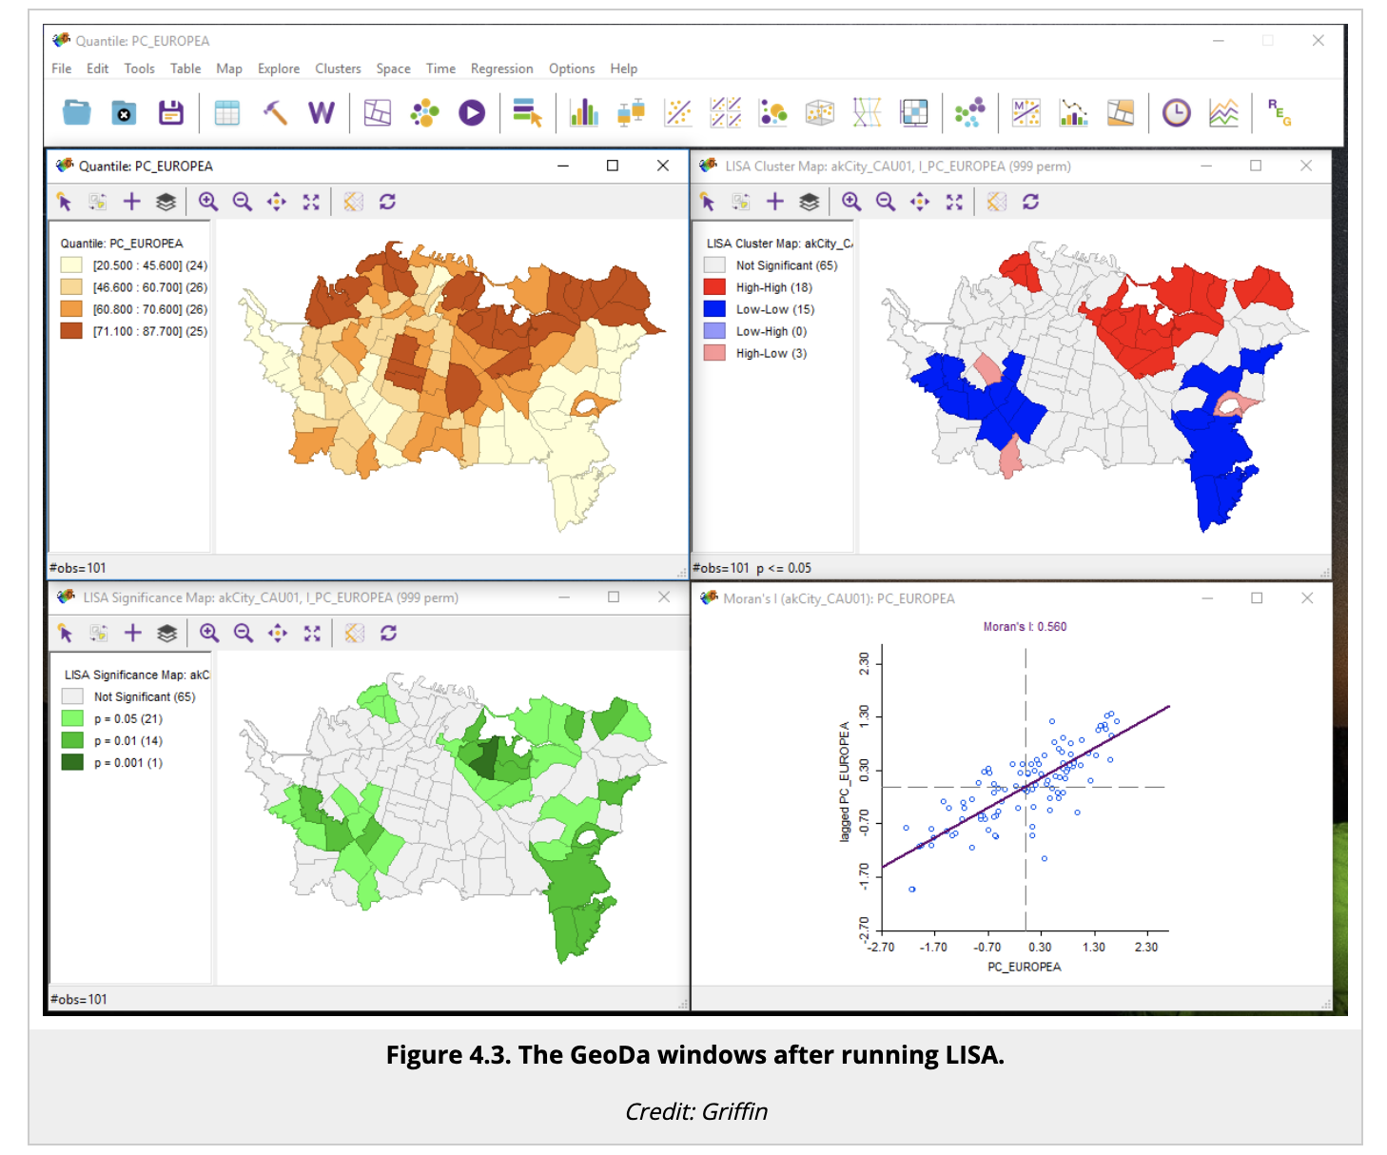

Slide 42
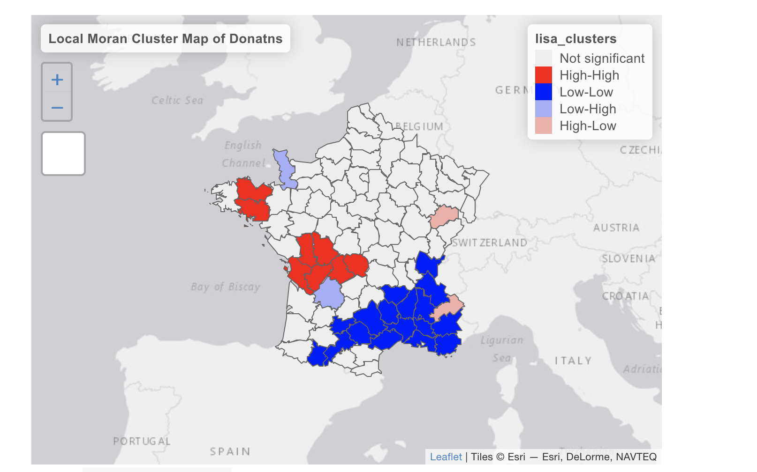

Slide 43
